Slide 1


Presented By:
Gaurav Nagpal
2019175
Section - B

Slide 2
Introduction
This is MERN technology based web application named as ‘get guidance’. This web app is developed to solve the problem of lack of communication between seniors and juniors.
This web application will be perfect place for the interaction of students.

Slide 3
Objectives
Fills the communication gap between seniors and juniors.
A website to share about upcoming College Events.
Article writing facility.
Fully responsive.

Slide 4






Technology Platform Overview
This website uses following technologies:-

Slide 5
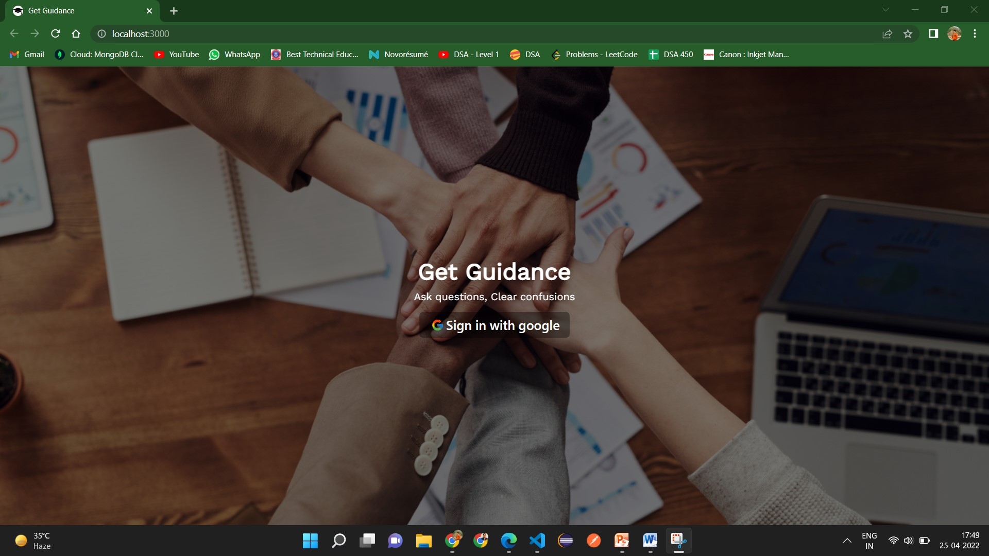
Application Features Overview
This website has the following features
Google Authentication:-

Slide 6
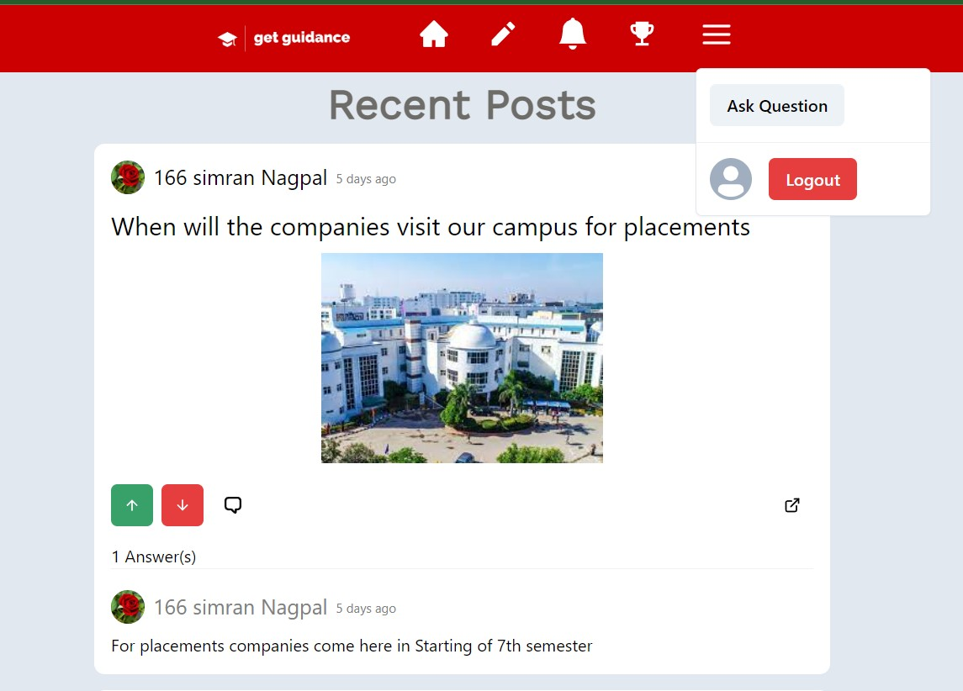
Ask Question :- It allows the students to add their question in real time.

Slide 7
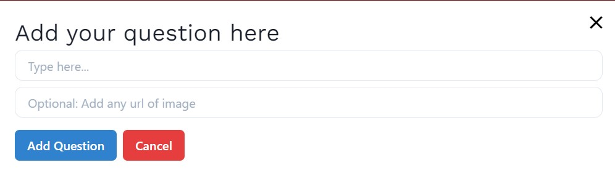
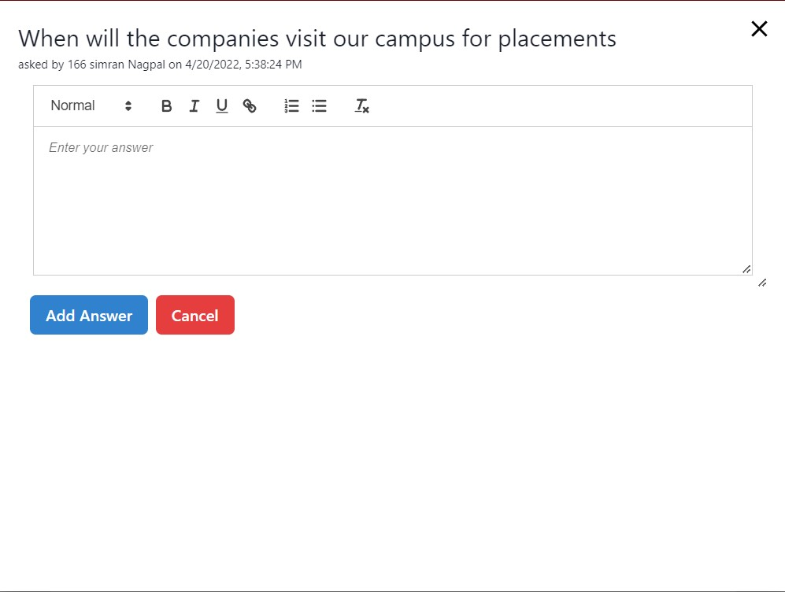
After clicking on Add Question:-
For Answering: Click on Answer button then following text editor will appear:-

Slide 8
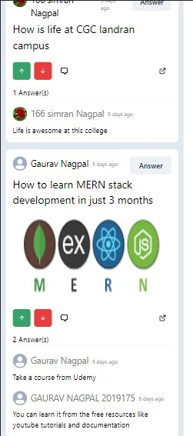
Fully responsive:- You can visit this website with your tablet, phone or laptop.

Slide 9
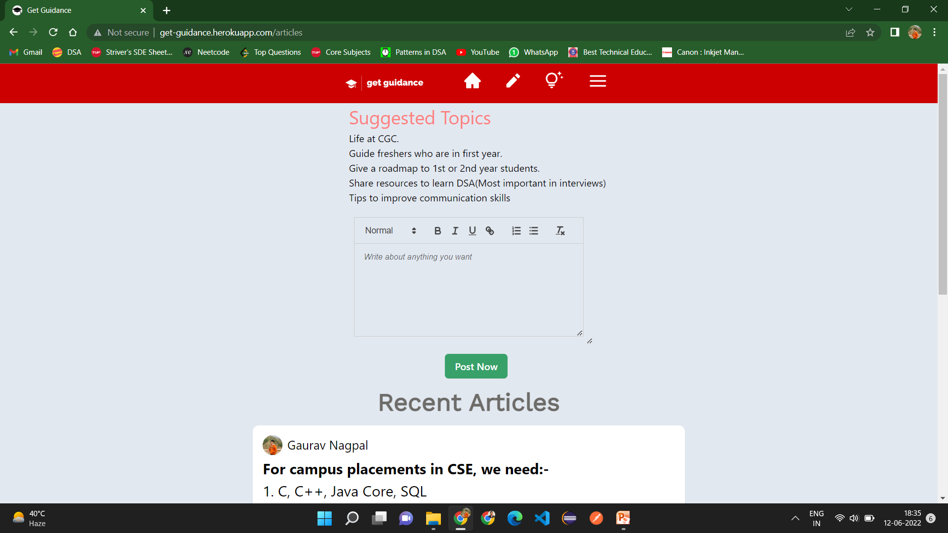
Article Writing
In this, students can write articles about the various topics(not academics).

Slide 10
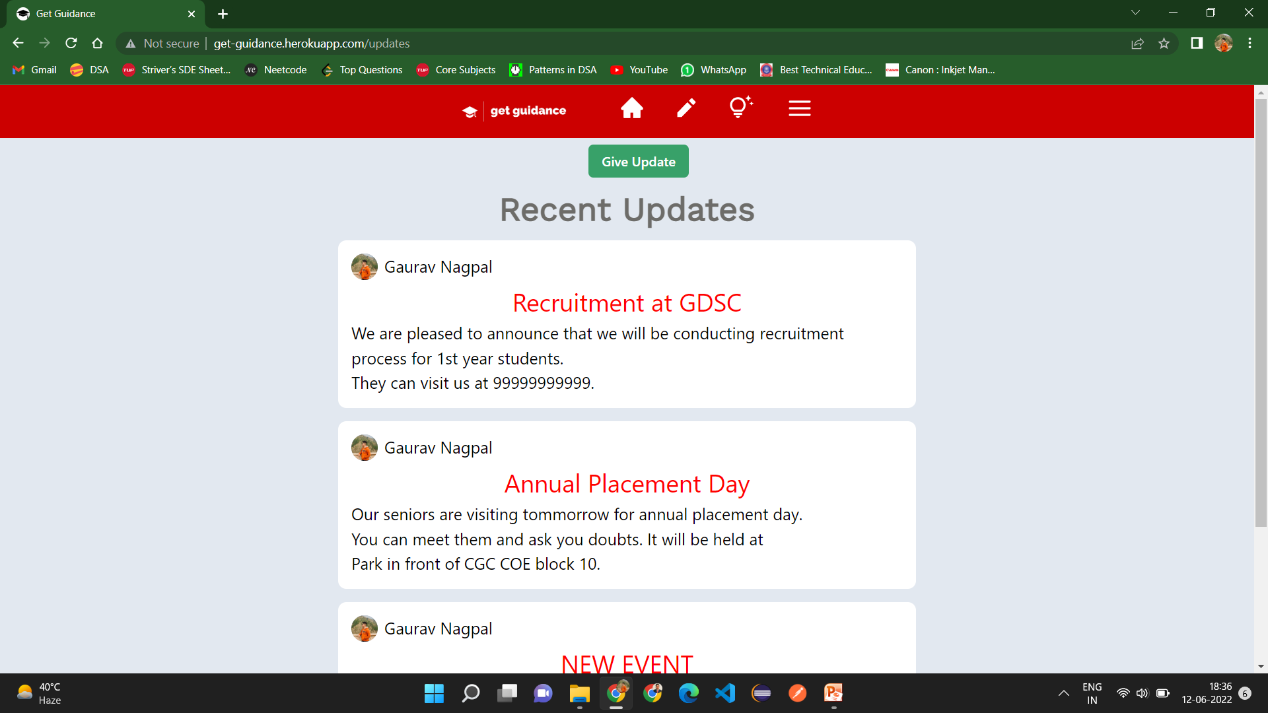
Updates
In this, the updates about the events in college will show.

Slide 11
Future Work
Development of Interests Section for students.
Notifications Support
Separate section for the recruitments for the College Clubs.

Slide 12
THANK YOU

